Slide 1
Lab # 5
Dated: Tuesday, October 19, 2010

Slide 2
Transfer of Control/Branch Instructions
A way of altering the order in which statements are executed.
Two Categories:
  Unconditional Transfer: The program branches to a new location in all cases. E.g. JMP instruction
  Conditional Transfer: The program branches if a certain condition is true. E.g. Loop instruction.

Slide 3
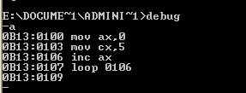
LOOP Instruction
LOOP instruction provides a simple way to repeat a block of statements a specific number of times.
CX is automatically used as a counter and is decremented each time the loop repeats.
Termination Condition: CX =0
Example:

Slide 4
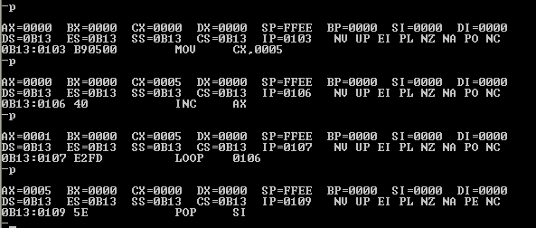
Contd..

Slide 5
JMP Instruction
The JMP instruction causes an unconditional transfer to the target location inside the code segment.
The location must be indentified by a code label.
JMP targetlabel

Slide 6
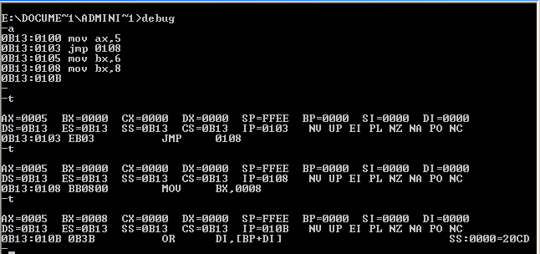
Contd..

Slide 7
Data Definition Directives
Variable: Symbolic name for a location in memory where data is stored.
In assembly language, variable is identified by labels.
Each label shows starting location of a variable.
A label, however, does not indicate how many bytes of storage are allocated for a variable.
Data Definition Directives used to allocate storage.

Slide 8
Data Types
 | Description | Bytes | Examples
DB | Define Byte | 1 | db ‘A’ db 10, 20,30,40
DW | Define Word | 2 | dw ‘AB’
DD | Define Double Word | 4 | dd -214743648
Possible Values: Numeric, String Constant, Constant Expression, ?
Possible Value for DD: binary number up to 0FFFFFFFF, a segment-offset address, a 4-byte encoded real number, or a decimal real number
8 Bit Number Range: Signed (-128 to 127), Unsigned (0-255)
16 Bit Number Range: Signed (-32,678 to 32767), Unsigned (0-65,535)
? To leave variable uninitialized

Slide 9

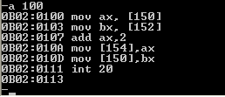
Example
Comments:
Assemble Data at Offset150
Define 2 word variables
Assemble code at offset 100
Move 1234 to AX
Move 5678 to BX
AX = 1236
Store 1236 at offset 154
Store 5678 at offset 150
End Program

Slide 10
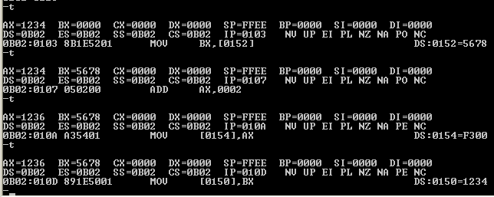
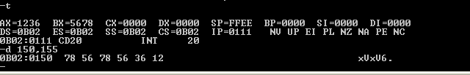
Output

Slide 11
Defining Procedure
A procedure is declared using the PROC and ENDP directive.
Every program has a startup procedure named as MAIN procedure.
Example
main Proc
.
.
main endp

Slide 12
Defining Procedure
When a procedure is created, other than the main procedure, end it with RET instruction.
Example
sample Proc
.
.
ret
sample Endp

